Slide 1

MOVIE RECOMMENDATION SYSTEM
BY Cynthia Jepkogei

Slide 2
TABLE OF CONTENTS
Introduction
Problem statement
Objectives
Patterns and findings
Conclusions
Recommendations

Slide 3
INTRODUCTION
Microsoft is the largest vendor of computer software in the world. It is also a leading provider of cloud computing services, video games, computer and gaming hardware, search, and other online services.
This project seeks to inform Microsoft Studios' decision to enter the original video content market, currently dominated by various large companies. Through an analysis of movie data from online databases, we have identified three key areas where Microsoft can leverage its strengths:

Slide 4
PROBLEM STATEMENT
Saturated Market: By partnering with established players and focusing on data-driven content selection, Microsoft can navigate the crowded market and compete effectively.
Lack of Experience: Strategic partnerships can bridge the gap in experience and provide valuable industry insights. Additionally, recruiting experienced personnel will bolster Microsoft's internal expertise.
Lack of Subject Matter Experts: Active recruitment of industry professionals can address the lack of subject-matter experts and equip Microsoft Studios with the necessary knowledge and skills to succeed in the competitive video content landscape.

Slide 5
OBJECTIVES
1. Market Penetration and Competitiveness: Develop strategic partnerships with established players in the saturated market to enhance Microsoft's market presence.
Implement a data-driven approach for content selection to ensure relevance and competitiveness.
2. Experience Enhancement: Foster strategic partnerships to gain valuable industry insights and bridge the experience gap.
Recruit experienced personnel to strengthen Microsoft's internal expertise and navigate challenges in the competitive landscape effectively.
3. Talent Acquisition for Subject Matter Expertise:
Actively recruit industry professionals and subject matter experts to address the shortage of specialized knowledge within Microsoft Studios.
Establish a robust recruitment strategy to acquire skilled professionals who can contribute to the success of Microsoft's ventures in the video content industry.
4. Strategic Alliance Building: Form alliances with key players in the industry to create mutually beneficial collaborations.
Leverage partnerships to gain a deeper understanding of market dynamics and stay ahead of trends.

Slide 6
Patterns and findings
1. Studio Partnerships:
Pattern: Established studios or streaming platforms contribute to success in the video content market.
2. Genre Preferences:
Pattern: Certain genres, such as dramas, documentaries, and comedies, tend to receive critical acclaim and perform well at the box office.
3. Talent Acquisition:
Pattern: Building a team with experienced professionals in film production, content creation, and streaming platform management is crucial for success.
4. Financial and Critical Success:
Pattern: Financial success and critical acclaim do not always correlate, suggesting a broader selection of talented directors.

Slide 7
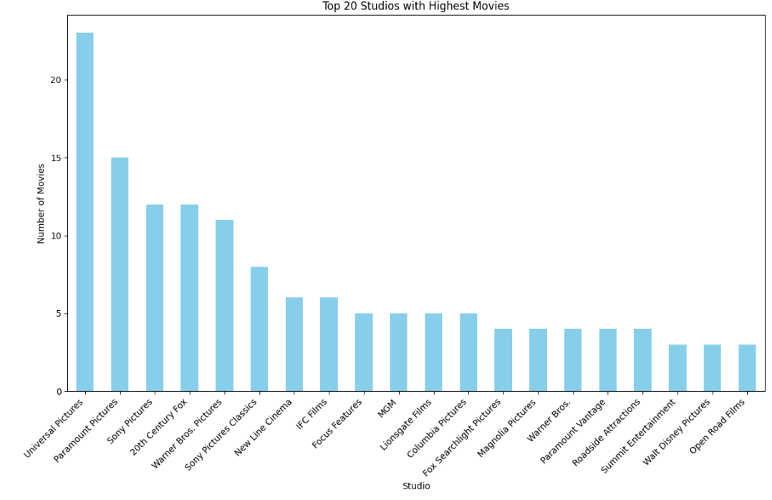

Slide 8
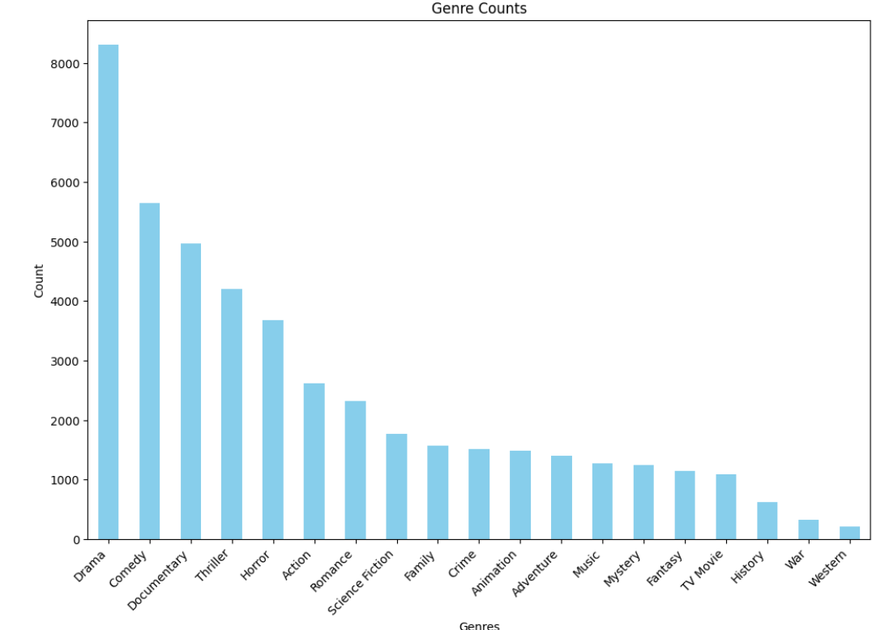

Slide 9
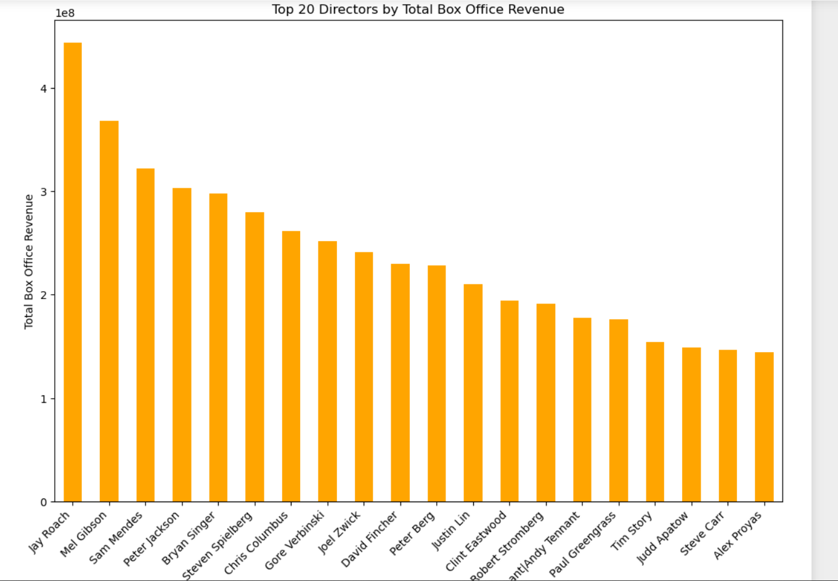

Slide 10
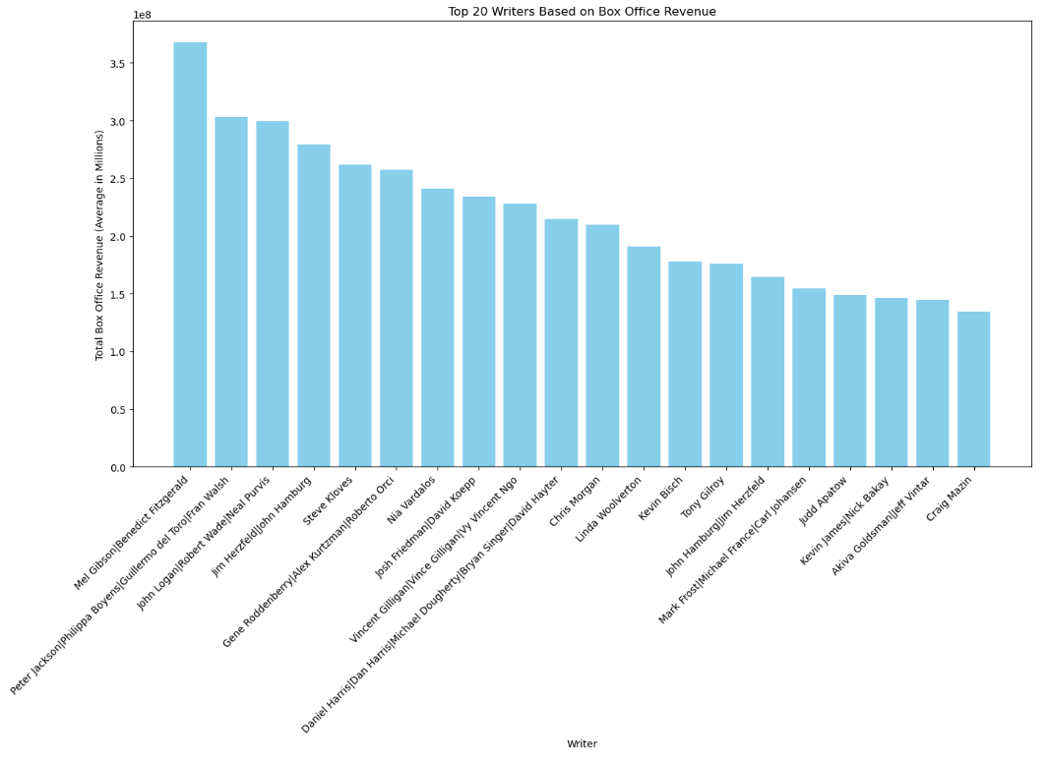

Slide 11
Conclusions
Entering the saturated video content market presents significant challenges for Microsoft. However, the insights from data analysis offer a clear roadmap to success. By leveraging established studios, strategically selecting content genres, and collaborating with talented directors and writers, Microsoft Studios can overcome the initial hurdles and establish itself as a reputable force in the industry.

Slide 12
Recommendations
Partner with studios like IFC Films and Sony Pictures to gain distribution channels and expertise.
Focus on producing dramas, documentaries, and comedies, as these genres tend to receive critical acclaim.
Collaborate with directors who have a proven track record of both financial and critical success. Consider hiring writers like Sebastien Lifshitz, Jamie Buckner, and Joe Camp for projects in the animation, documentary, and drama genres, respectively.

Slide 13
CONTACT ME
LinkedIN
GITHUB
Cynthia Jepkogei

